Slide 1
Agenda for GEOG260/360 GIS & Land Change Models
September 20
Discuss some vocabulary and concepts
Get instructions for Assignment 3
Work on Assignment 3
Read Chapters 2 & 3 of Metrics That Make a Difference
Read The total operating characteristic to measure diagnostic ability for multiple thresholds
September 25
Discuss Assignment 3
September 27
Submit Assignment 3 by 4pm on Canvas
Get instructions for Assignment 3

Slide 2
Modeling Vocabulary
Deductive modeling begins with a theory of the process, then the modeler creates the simulation algorithm follow the theory.
Inductive modeling begins with detecting a pattern, then the modeler creates the simulation algorithm to extrapolate the pattern.
Validation is the procedure to measure whether the simulation matches what actually exists.
Verification is the procedure to determine whether the behavior of the algorithm matches the model’s documentation.
Temporal Stationarity means that the pattern or process during one time interval matches the corresponding pattern or process during the subsequent time interval.

Slide 3
Is Geomod a Deductive or Inductive Model?

Slide 4
Is Geomod a Deductive or Inductive Model?
Geomod’s constraint allows for a deductive feature. If you have a theory that people build near previous built, then you run the model in constrained mode regardless of what the data show. This theory required 5 seconds to create.
Geomod’s method to compute the suitability map is inductive. Geomod has no theory of why builders target some elevations and avoid other elevations. Geomod computes the empirical pattern then extrapolates the pattern.

Slide 5
Is Geomod a verified model? Is Geomod a valid model?

Slide 6
Is Geomod a verified model? Is Geomod a valid model?
If Geomod behaves as Geomod’s documentation claims and as Pontius intended, then Geomod is verified.
It does not make sense to state that a model is valid or not. It makes sense to test the validity of a particular simulation for a particular application and combination of parameters.
If the calibration time interval uses an irrelevant variable, then pattern validation will find that the extrapolation is not valid.
If temporal non-stationarity causes the pattern during the calibration time interval to differ from the pattern during the validation time interval, then pattern validation will find that the extrapolation is not valid.
How should we assess Geomod’s run1 validation for Assignment 2?

Slide 7
How should we assess validation, given the following?
Run 1
The simulated quantity of built gain for run 1 derives from extrapolation of linear interpolation through 1971 and 1985.
The simulated allocation of built gain for run 1 derives calibration of a suitability map based on an overlay of built at 1985 and elevation.
Run 2
The simulated quantity of built gain for run 2 derives matching the actual size of built gain in the maps at 1985 and 1999 in each town.
The simulated allocation of built gain for run 2 derives calibration of a suitability map based on an overlay of built at 1985 and elevation, geology, 1971 land use, and protected status.

Slide 8
How should we perform validation?
If you compare the 1999 simulation map with the 1999 reference map, then:
Will you be able to see the reference change during 1985-1999?
Will you be able to see the simulated change during 1985-1999?

Slide 9
Reference 1999

Slide 10
Simulated 1999 Run 1 is 93.1 % correct

Slide 11
Simulated 1999 Run 2 is 93.3 % correct

Slide 12
Reference 1985 is 96 % correct, why?

Slide 13
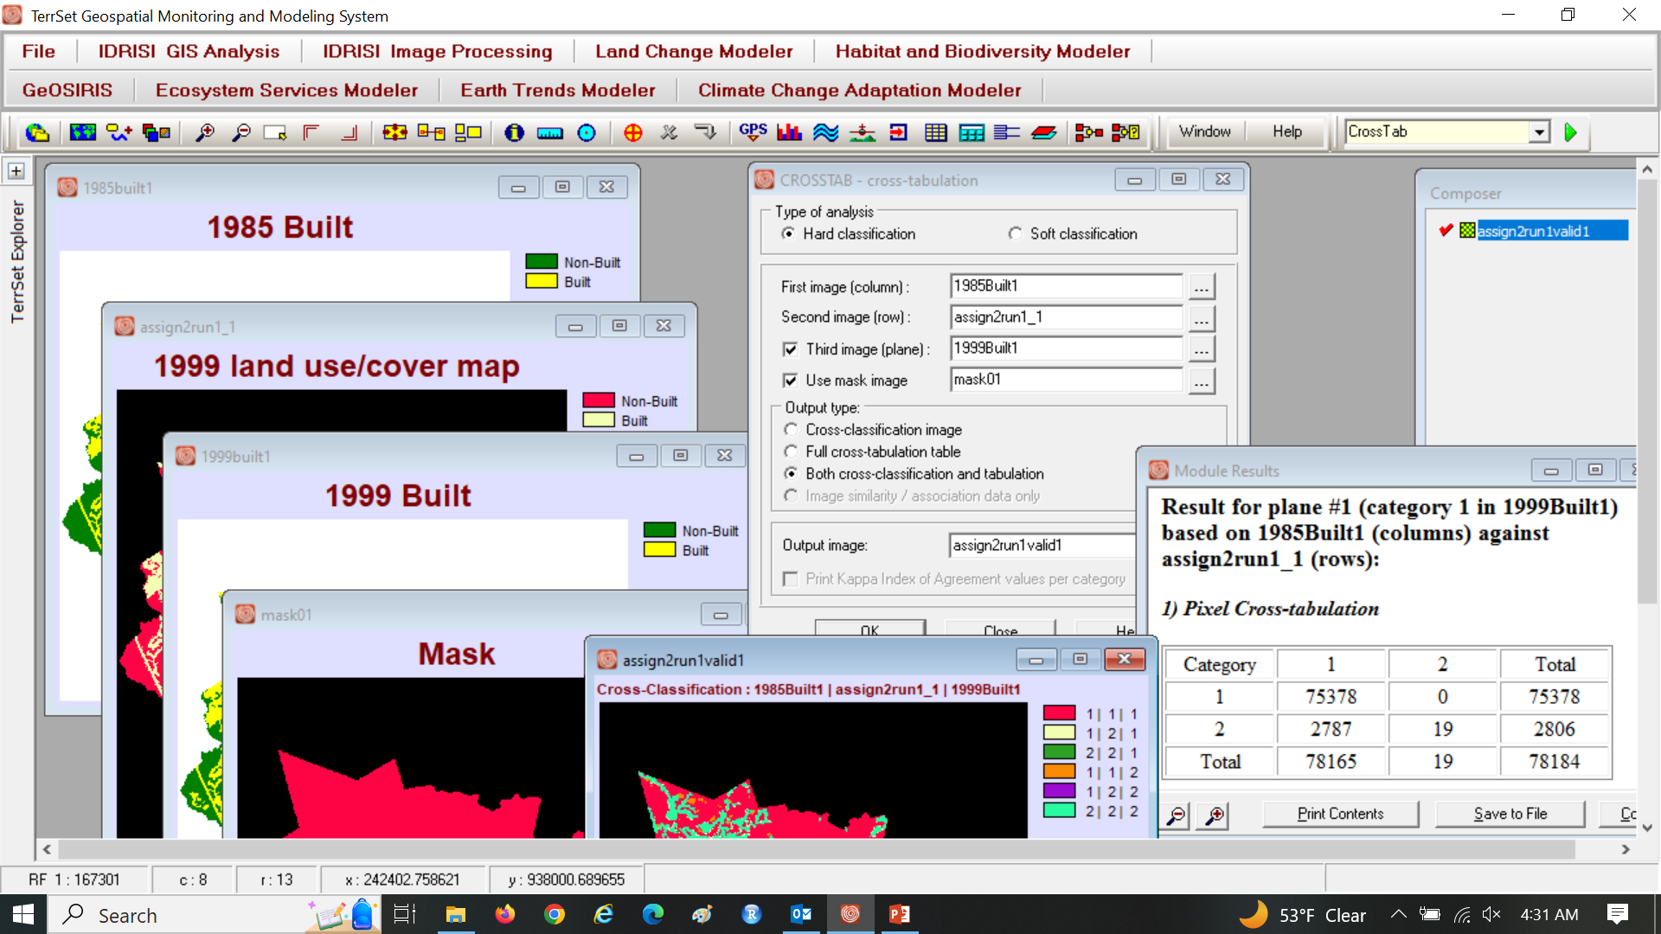
Use three map CROSSTAB

Slide 14
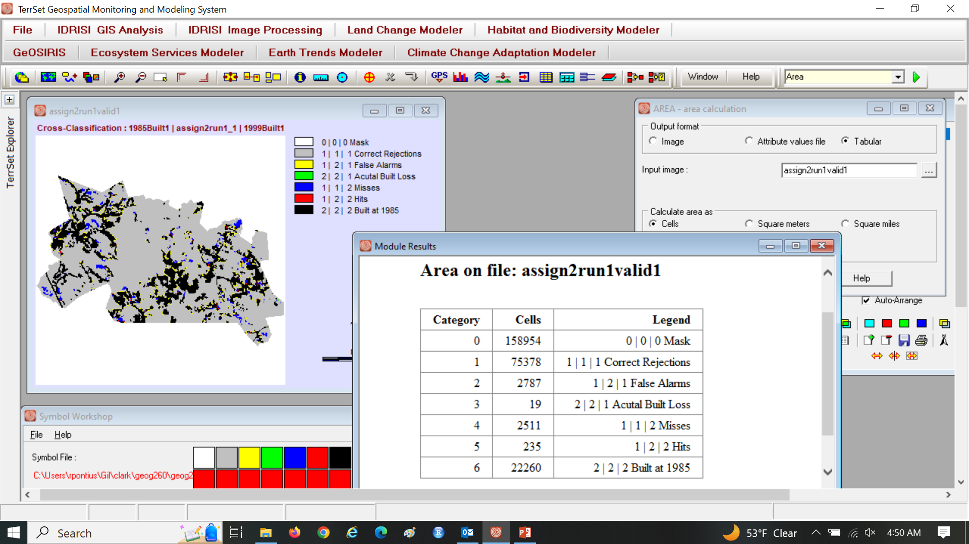
Edit the legend and colors

Slide 15
Which color(s) are the simulated change? Which color(s) are the actual change? Why are False Alarms larger than Misses? What is the result of this run’s validation? What is the result of Geomod’s verification?

Slide 16
Which color(s) are the simulated change? Yellow and Red, meaning False Alarms and Hits. Which color(s) are the actual change? Green, Blue, and Red, meaning Actual Built Loss, Misses, and Hits. Why are False Alarms larger than Misses? The size of extrapolated change is larger than the size of actual change. What is the result of this run’s validation? Hits are fewer than the sum of False Alarms and Misses. What is the result of Geomod’s verification? Geomod performed as advertised.

Slide 17
False Alarms and Misses are validation errors. Run1 specified the quantity and the allocation. Is the incorrect quantity or incorrect allocation responsible for most of the error?

Slide 18
False Alarms and Misses are validation errors. Run1 specified the quantity and the allocation. Is the incorrect quantity or incorrect allocation responsible for most of the error? Quantity error = |2787 - 2511| = 276 < 5022 = (2787 + 2511) – 276 = Allocation error.

Slide 19
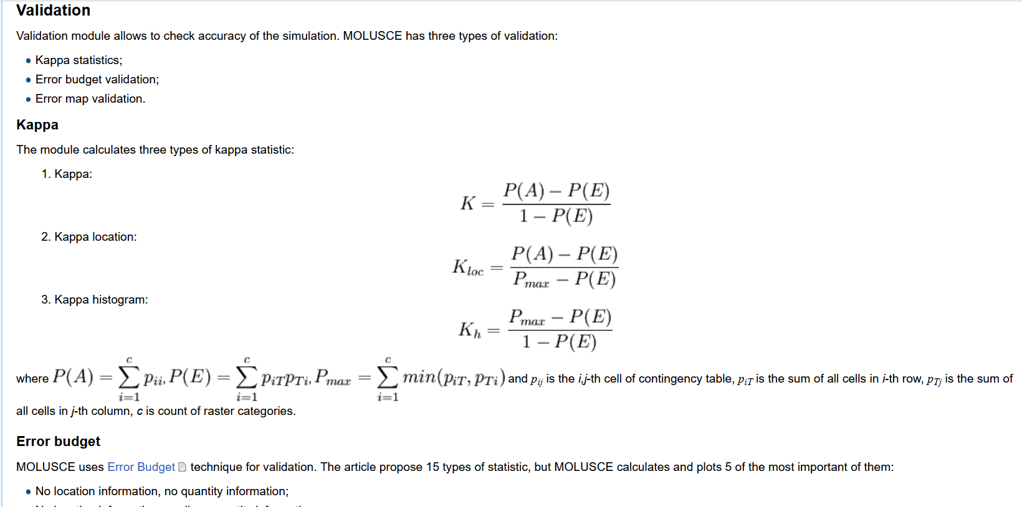
A major source of improper validation is QGIS https://wiki.gis-lab.info/w/Landscape_change_analysis_with_MOLUSCE_-_methods_and_algorithms#Validation An example is https://www.mdpi.com/2073-4441/13/16/2286
MOLUSCE is a QGIS plugin for Land Use Change Evaluation.
MOLUSCE abbreviation stands for Methods Of Land Use Change Evaluation.

Slide 20
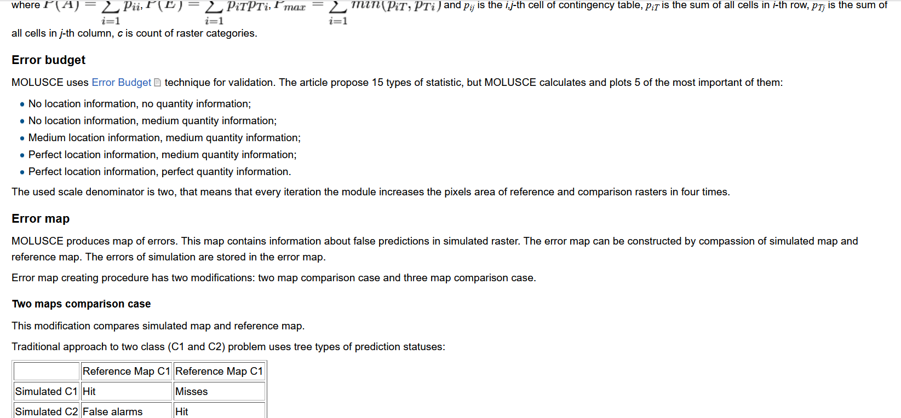
A major source of improper validation is QGIS https://wiki.gis-lab.info/w/Landscape_change_analysis_with_MOLUSCE_-_methods_and_algorithms#Validation An example is https://www.mdpi.com/2073-4441/13/16/2286

Slide 21
Assignment 3
Use the maps in ForestOtherBuilt2.zip from Canvas. Perform three simulations of Geomod that use 1985Built as the Beginning landuse image, Mask01 as mask, 1985 as beginning time, 1999 as ending time, 14 as time step, neighborhood search mode unconstrained, Driver map is 1971landuse21cats01 with weight as 1, do not do environmental impact analysis, and do not output interim time images, make the output name match the name on the first panel. For Run 1, set the quantity to make the simulation match the validation map at 1999. For Run 2, set the quantity for State 1 END to 40456, which is half of State 1 BGN.
For both runs, perform validation by using CROSSTAB with 1985Built, 1999Simulation, 1999Built and mask01. Make an intuitive color palette and edit the legend to describe in words each combination from the CROSSTAB. Report the number of pixels of each category in the CROSSTAB.
Submit one PPTX file that has exactly four slides. Slide 1 is a title slide with the author(s) name(s). Slide 2 shows the suitability map and validation map for the first run. Slide 3 shows the suitability map and validation map for the second run. On slides 2 and 3, explain the relationship between the number of false alarms and the number of misses for each run. Slide 4 shows and explains the TOC curve on the next slide. State the points where each run would appear on the TOC curve. Interpret the shape of the TOC curve in terms of the 1971landuse categories. Explain what we learn from the slopes of the segments of the curve near the origin, compared to the slopes of the segments of the curve near the upper right corner. Explain the role of stationarity in the interpretation of the TOC curve.

Slide 22
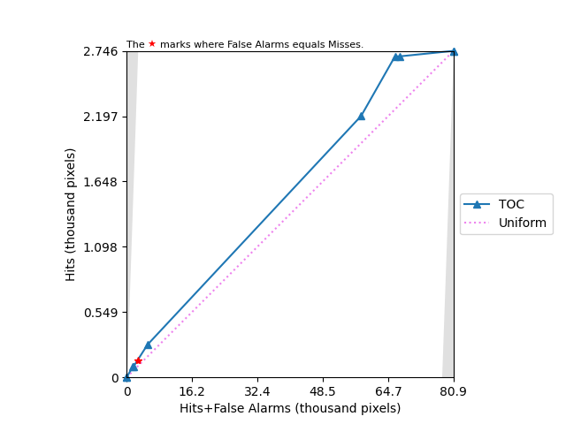
TOC curve for Assignment 3

Slide 23
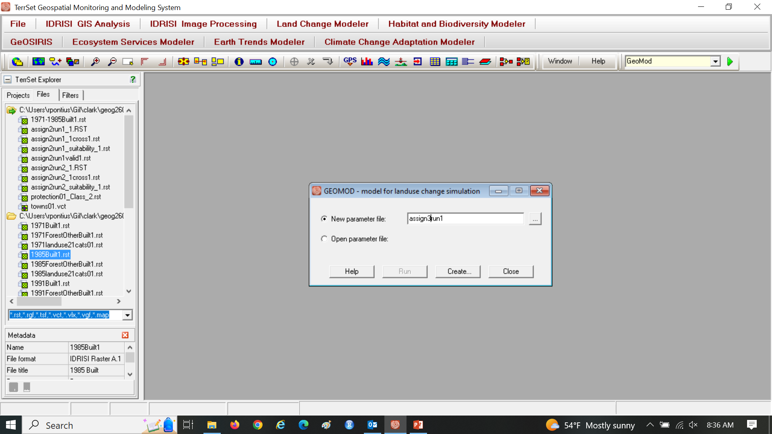
Assignment 3

Slide 24
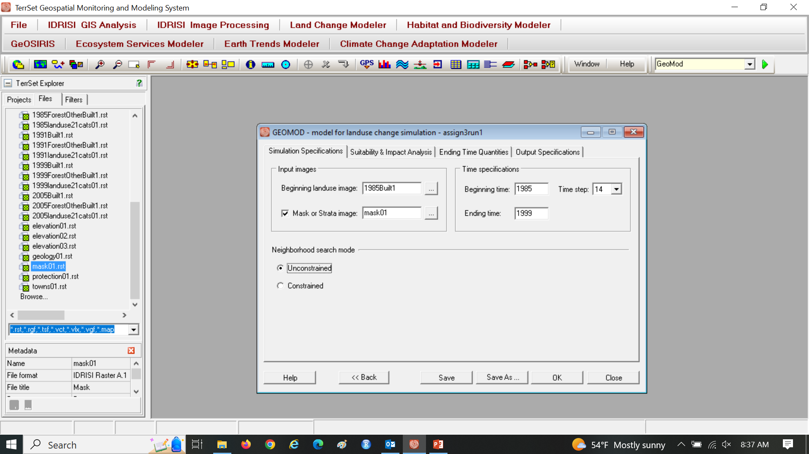
Assignment 3

Slide 25
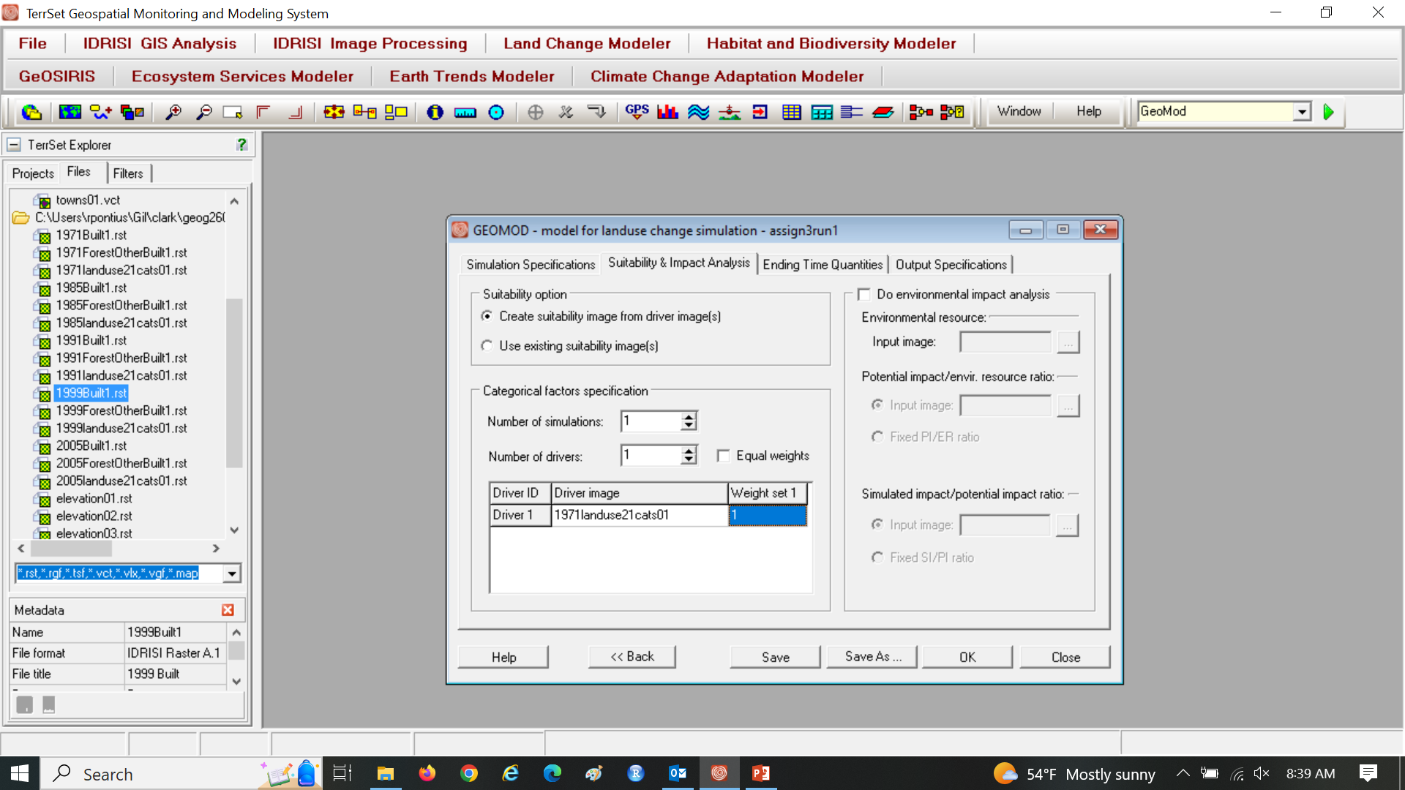
Assignment 3

Slide 26
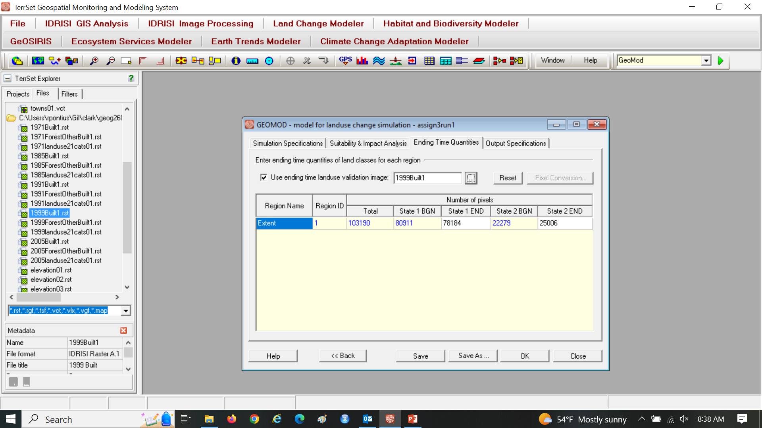
Assignment 3

Slide 27

Assignment 3

Slide 28
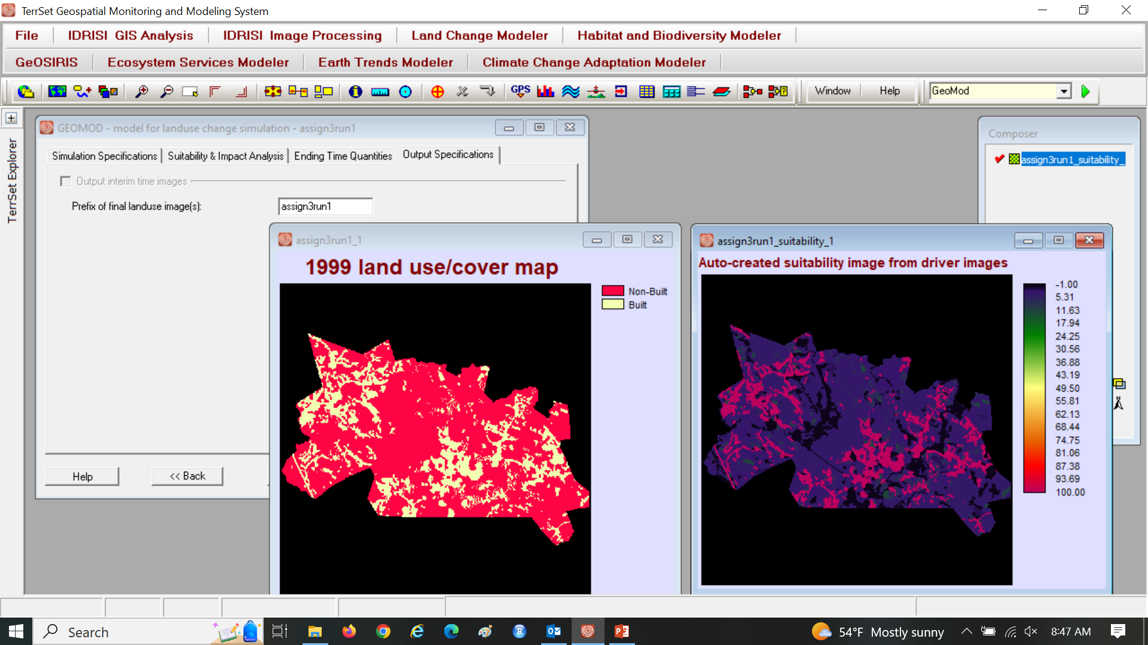
Assignment 3 Run 1

Slide 29
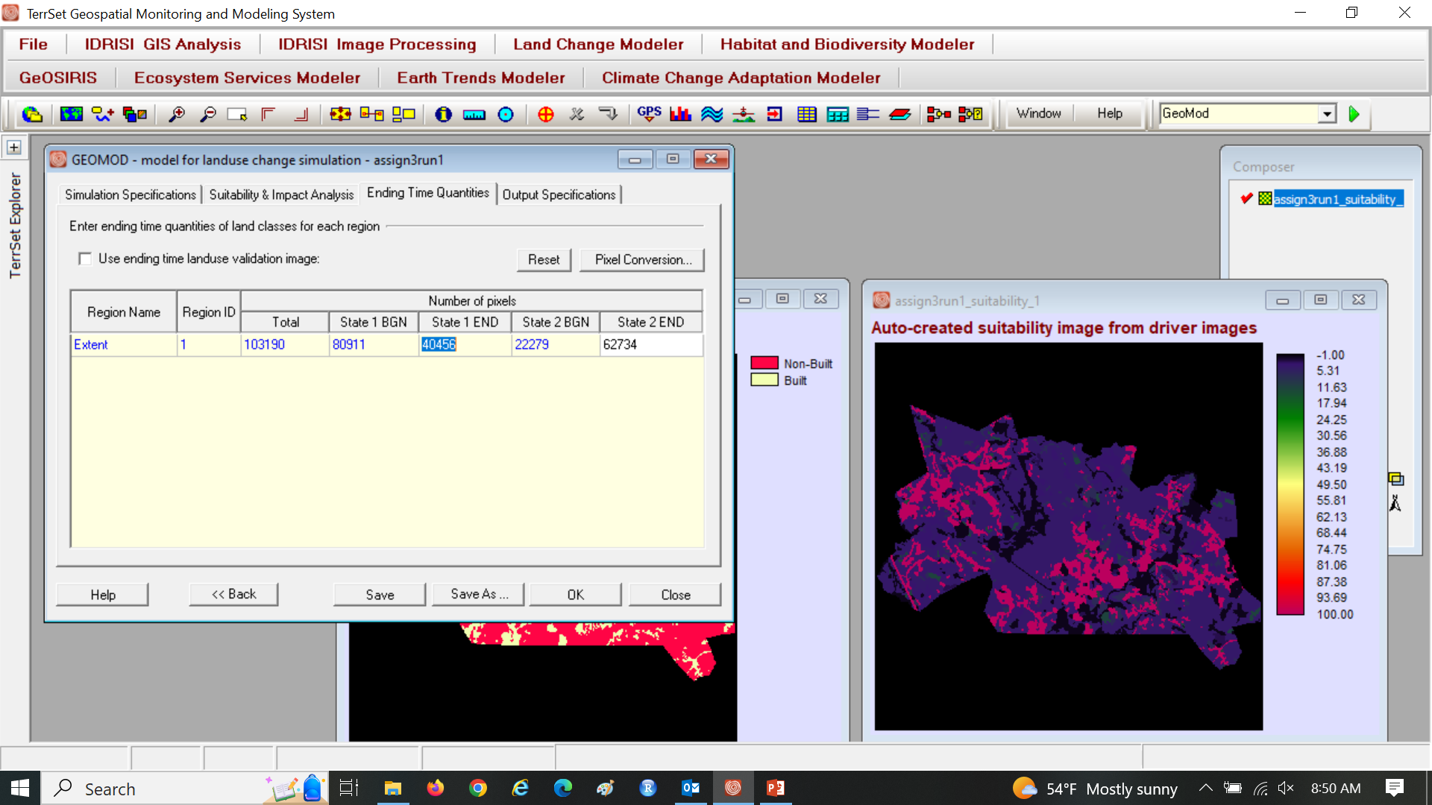
Assignment 3

Slide 30
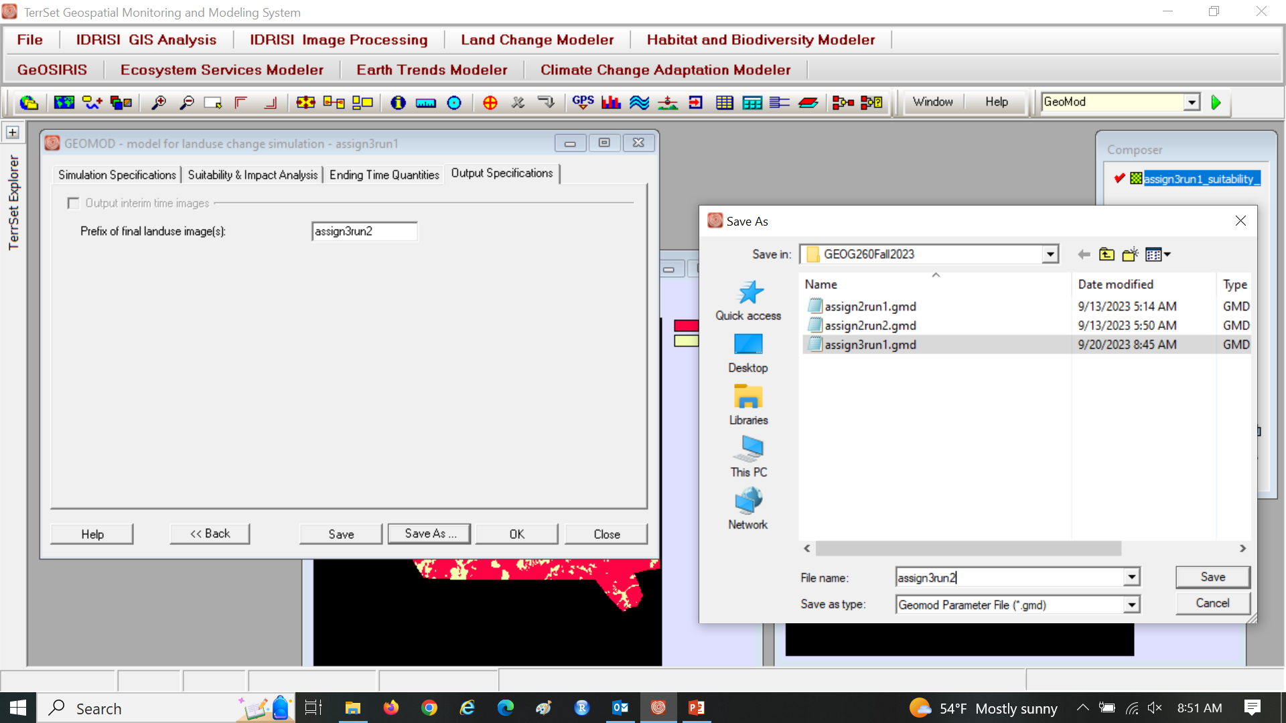
Assignment 3 Save Prefix and GMD file as assign3run2

Slide 31
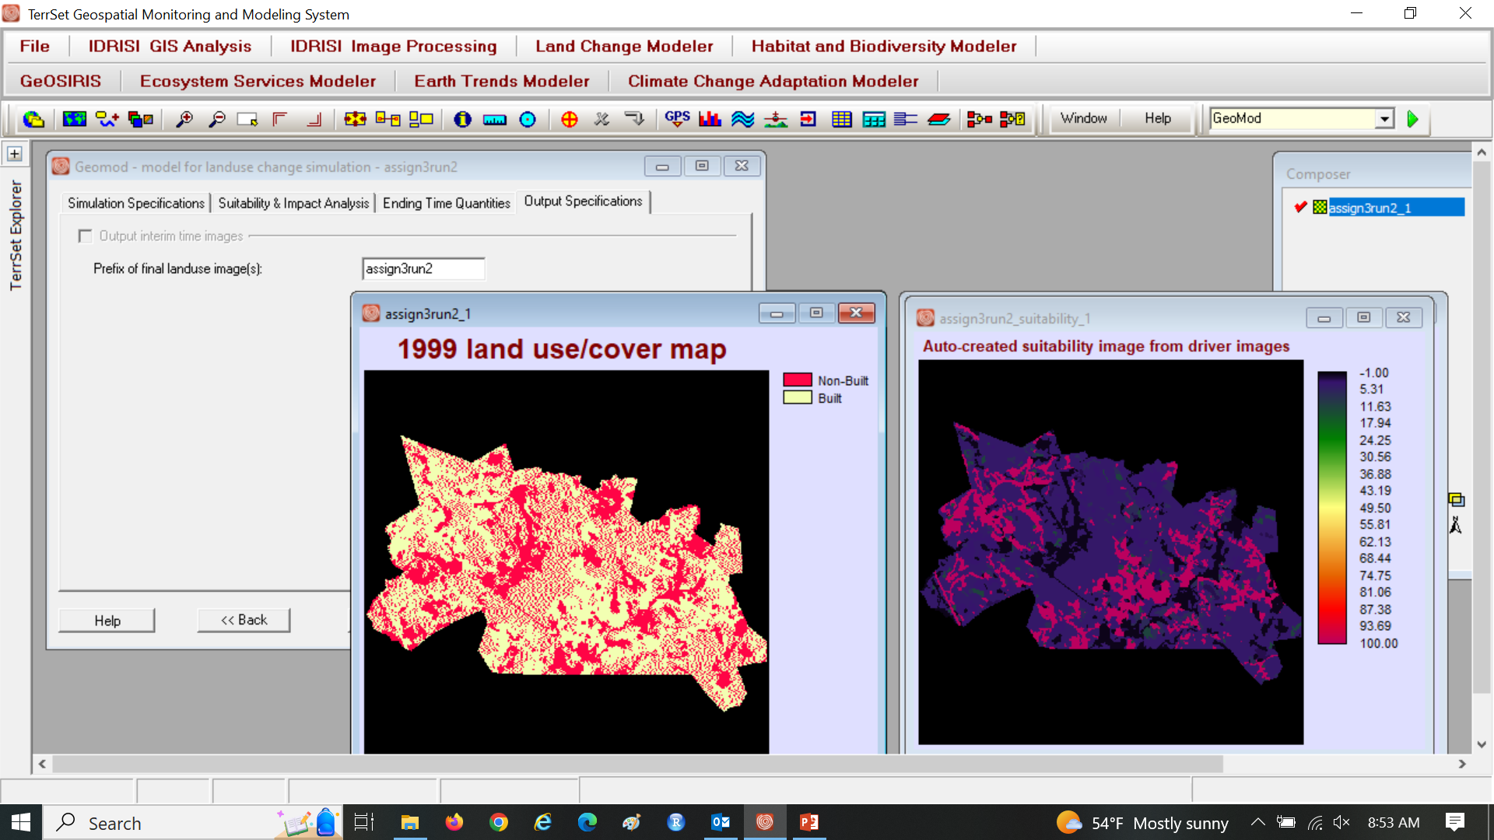
Assignment 3

